Slide 1


Game Engines 1
Newtonian Physics
Dr Bryan Duggan
DIT School of Computing
bryan.duggan@dit.ie
@ditcomputing
http://facebook.com/ditschoolofcomputing

Slide 2
Introduction
So far, we have been using vector arithmetic to move and position entities
This is known as Euclidian Geometry
This is probably ok for projectiles, but does not result in realistic behaviour
In the real world, the laws governing things that move have been known for centuries
This is known as Newtonian Physics

Slide 3
These laws govern things like…
Force
Acceleration
Friction
Gravity
Energy
Heat
Collisions
Motion
All these things can be predicted using simple equations, therefore it is possible to program them into a game

Slide 4
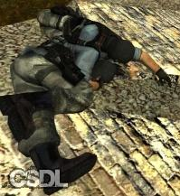

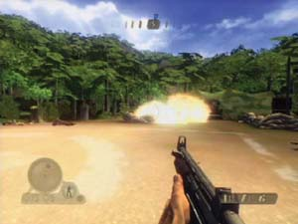
Physics in games
Ragdolls
Car racing
Physics puzzles
Exploding barrels

Slide 5
Why?
Don’t have to script all behavior (easier content
creation?)
But: hard to script any behavior. Lack of artist control.
Improved realism and world consistency.
Objects “do the right thing” – but only if the model is good
Emergent behavior.
Often pleasantly surprising, often annoying. Game design must allow for unpredictable outcomes.
Players can exercise more creativity and control.
World building, story telling.
Other problems:
Extra control / AI needed for virtual creatures.
More computation needed – eats the CPU budget.

Slide 6

Physics Engines
You can licence a physics engine and include it in your game to save you doing the programming yourself.
The big names include:
Havok
Bullet
Newton Game Dynamics
Open Dynamics Engine (Open Source)

Slide 7
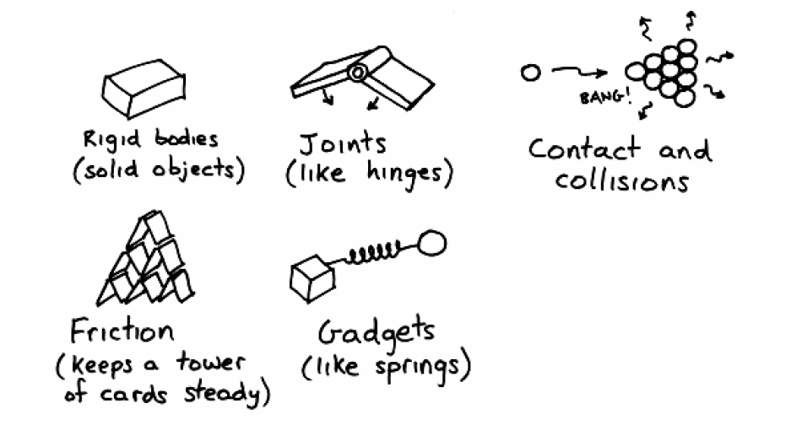
What does it do?

Slide 8
Physics background
Time
Scalar measured in seconds (s)
Distance
Scalar measured in Meters (m)
Mass
A measure of the amount of something
Scalar measured in Kg
It is calculated as the force of gravity acting on an object
Unit of matter
Position
A vector (so you have an origin)
Its position relative to the origin
The position of an entities centre of mass
Balance point
The average location of all its mass

Slide 9
Physics background
Velocity
A vector (has magnitude and direction) in m/s
Magnitude is the speed
v = Δx / Δt
Δx = Change in distance
Δt = Change in time

Slide 10
Examples
To calculate velocity:
If a ball travels 5 meters in 2 seconds, its velocity is:
v = 5/2 = 2.5 m/s
To calculate displacement:
Rearrange equation:
Δx = v Δt
To calculate positions:
If an object starts at 5 and is travelling at 10 m/s, after 3.5 seconds
P[t+1] = P[t] + vΔt
P[t+1] = 5 + (10 * 3.5) = 40

Slide 11
Acceleration
Vector quantity representing the rate of change in velocity over time
m/s/s or m/s²
a = Δv / Δt
In other worlds change in velocity / the time interval in which the change took place

Slide 12
Example
If a car starts from rest and accelerates at 2 m/s^{2,} then every 2 seconds, 2 m/s is added to the velocity
Time | Velocity
0 | 0
1 | 2
2 | 4
3 | 6

Slide 13
Relationship between velocity, time and acceleration

Slide 14
Relationship between velocity, acceleration and time
The equation y = mx + c can be used to calculate points on a line, where m is the gradient and c is the intercept
As constant acceleration is a straight line, y axis is velocity, x axis is time
v = at + u
v = velocity
a = acceleration
t = time
u = velocity at time t = 0

Slide 15
Example
Determine the velocity of a car starting with a velocity of 3 m/s and accelerating at 2 m/s² for 3 seconds
v = 2 * 3 + 3 = 9 m/s

Slide 16
Distance
Distance is = the area under the graph.
E.g.
In graph 1, Distance = velocity * time

Slide 17
Distance
Area A = Δt * u
Area B = .5 * (v-u) Δt
Therefore Δx = u Δt + .5(v-u) Δt
We know v-u = Δv and
Δv = a Δt
So we can use:
Δx = u Δt + .5 a Δt²
t
v-u
B
A
u

Slide 18
Force
Force is that quality that can alter an objects speed or direction
Force is nothing to do with motion
Force is only required to affect a change
For example no force is required to keep an arrow flying, only to start it off
Many forces can act on an object at the same time. If the sum of those forces is 0, the object will not change velocity

Slide 19
Friction
Gravity
Force
from
the table
Gravity
Force
from
wind
Buoyancy
Gravity
Friction

Slide 20
Calculating acceleration
a = F/m or F = ma
a = acceleration
F = Force
m = mass
Example:
If the boat in the diagram has a mass of 2000kg and is accelerating at 1.5m/s²
The force acting on the boat is:
2000 * 1.5 = 3000N

Slide 21
Also!
If we know:
Force, position mass and time
We can calculate the acceleration and update the position and velocity

Slide 22
Example
class SpaceShip
{
private:
D3DXVECTOR3 _pos;
D3DXVECTOR3 _velocity;
float _mass;
}
SpaceShip::update(float timeDelta, D3DXVECTOR3 * force)
{
D3DXVECTOR3 acceleration;
// First calculate the acceleration
acceleration = * force / _mass;
// Now calculate the change in velocity due to acceleration
_velocity += acceleration * time;
// Now update the position
_pos += _velocity * timeDelta;
}

Slide 23
In summary
F = Ma
a = Δv/Δt
v = Δx/Δt
Δx = v Δt
Δx = u Δt + .5 a Δt²

Slide 24
Problem 2
A person is located at position (0,0)
The person has a Mass of 150Kg’s
How much force is required to move the person to a position of (20, 20) in 20 seconds

Slide 25
Problem 3
If person is located at a position of (15, 5) and travelling at a velocity of (2, 2), calculate the force that should be applied to move the person to a position of (-7, 6) in 10 seconds

Slide 26
Problem 4
If an item is dropped from the top of the empire state building, what will its velocity be by the time it reaches the ground, given that the height of the building is 381m
Acceleration due to gravity is 9.8M/s/s

